Slide 1

GEKKO Optimization Suite
CAST Webinar
8/23/18
Logan Beal

Slide 2
Quick Start Guide
Install GEKKO with pip
18 Examples: https://goo.gl/guA2a6
pip install gekko

Slide 3
Overview
Free AML in Python for LP, QP, NLP, MILP, and MINLP
Easy to install, intuitive syntax
Integrated model formulation, solution, and visualization

Slide 4
Overview
Specialization in dynamic optimization
Full-featured MHE and MPC for industrial, online applications
Model reduction and initialization strategies
Warm-start initialization from time-shifting of solutions

Slide 5
Python

Slide 6

Why Python
Easy, flexible, pretty
Popular
IEEE #1
TIOBE #4
Large community
~9% new stack overflow questions
Many powerful packages
matplotlib, numpy/scipy, pandas, openOPC/pymodbus
pip install

Slide 7
AML Features

Slide 8
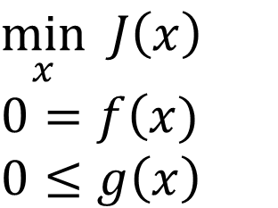
Standard AML Problem
AMPL, GAMS, Pyomo, JuMP, CasADi, etc all address this problem
Automatic Differentiation
Fast Fortran back-end
Bundled solvers
$$\min_{x} J\left.\left(x\right.\right)$$
$$0=f\left(x\right.)$$
$$0≤g\left.\left(x\right.\right)$$

Slide 9
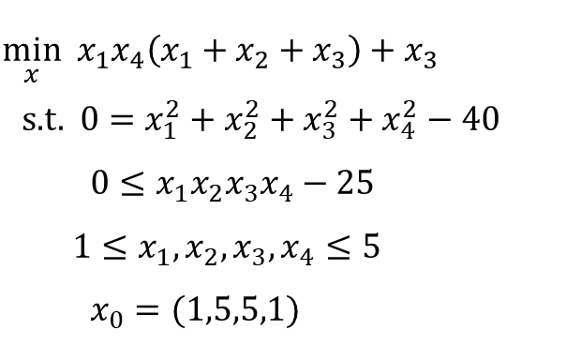
HS71
Problem Statement
GEKKO Code
from gekko import GEKKO
m = GEKKO() # Initialize gekko
# Initialize variables
x1 = m.Var(1, lb = 1, ub = 5)
x2 = m.Var(5, lb = 1, ub = 5)
x3 = m.Var(5, lb = 1, ub = 5)
x4 = m.Var(1, lb = 1, ub = 5)
# Equations
m.Equation(x1 * x2 * x3 * x4 >= 25)
m.Equation(x1**2 + x2**2 + x3**2 + x4**2 == 40)
m.Obj(x1 * x4 * (x1 + x2 + x3) + x3)
# Objective
m.options.IMODE = 3# Steady state optimization
m.solve()# Solve
print('Results')
print('x1: ' + str(x1.value))
print('x2: ' + str(x2.value))
print('x3: ' + str(x3.value))
print('x4: ' + str(x4.value))
$$\min_{x} x_{1}x_{4}\left(x_{1}+x_{2}+x_{3}\right)+x_{3}$$
s.t. $0=x_{1}^{2}+x_{2}^{2}+x_{3}^{2}+x_{4}^{2}−40$
$0≤x_{1}x_{2}x_{3}x_{4}−25$
$1≤x_{1},x_{2},x_{3},x_{4}≤5$
$x_{0}=(1,5,5,1)$

Slide 10
Dynamic Optimization

Slide 11
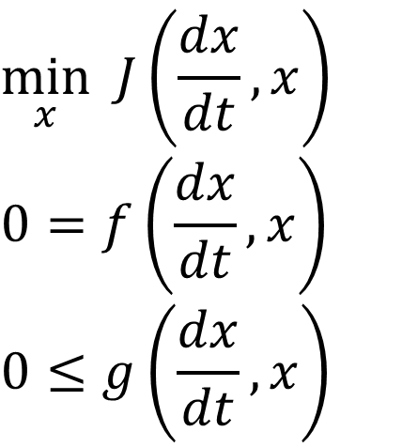
ODE Discretization
$$\min_{x} J\left.\left(\frac{dx}{dt},x\right.\right)$$
$$0=f\left.\left(\frac{dx}{dt},x\right.\right)$$
$$0≤g\left.\left(\frac{dx}{dt},x\right.\right)$$
Extend AML general problem to natively handle differential equations
Orthogonal collocation on finite elements
Provide model time discretization:
m = GEKKO()
m.time = [0,1,2,3]

Slide 12
Simultaneous vs Sequential
Sequential
Feasible solutions
Easy to implement
Computationally inefficient
Simultaneous
Faster for large problems
Easy to implement variable bounds
Difficult to implement correctly
Infeasible solutions are worthless

Slide 13
Common Implementations
Model Predictive Control
IMODE = 6
Moving Horizon Estimation
IMODE = 5
Dynamic Real Time Optimization
Economic Model Predictive Control

Slide 14
Custom Variable Types
Fixed Variable
Manipulated Variable
State Variable
Controlled Variable

Slide 15
Fixed Variable (FV)
Fixed throughout the horizon
Built-in tuning
m = GEKKO()
x = m.FV()
x.STATUS = 1
x.DMAX = 1

Slide 16
Manipulated Variable (MV)
0- or 1-order hold, like DCS
Tuning options:
DCOST (Move suppression)
DMAX (Move constraint)
m = GEKKO()
x = m.MV()
x.STATUS = 1
x.DCOST = 1
m.options.MV_TYPE = 0

Slide 17
State Variable
Added attributes for inspection
m = GEKKO()
x = m.SV()
# ...
# model
# ...
m.solve()
print(x.PRED)

Slide 18
Controlled Variable
Build objectives based on mode:
Minimize error to setpoint
Minimize error between model/measurements
Tuning
TAU (Time constant)
m = GEKKO()
x = m.CV()
x.STATUS = 1 #build objective
m.options.CV_TYPE = 2 #squared error
x.SP = 5
# or
m.options.CV_TYPE = 1 #absolute error
x.SPHI = 6
x.SPLO = 4

Slide 19
Intermediates
Reduce size of matrix math
Ensure feasible solution to given equations
Must be defined explicitly
#Rate equations
k = m.Var()
m.Equation(k == k0 * m.exp(-E/(R*T)))
m.Equation(rate == k * Ca)
# OR
k = m.Intermediate(k0 * m.exp(-E/(R*T)))
m.Equation(rate == k * Ca)
Model Reduction

Slide 20
Examples

Slide 21
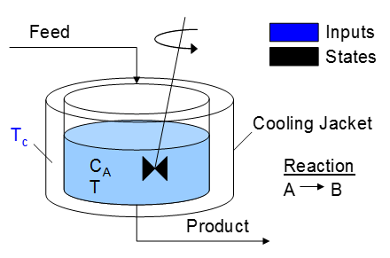
CSTR Model
Model
RTO
NMPC
Tune NMPC

Slide 22
Initialize
from gekko import GEKKO
import numpy as np
import matplotlib.pyplot as plt
#%% NMPC model
m = GEKKO(remote=False)
m.time = np.linspace(0,5,51)

Slide 23
Variables
#Model Parameters
q = m.Param(value=100)
V = m.Param(value=100)
rho = m.Param(value=1000)
Cp = m.Param(value=0.239)
mdelH = m.Param(value=50000)
ER = m.Param(value=8750)
k0 = m.Param(value=7.2*10**10)
UA = m.Param(value=5*10**4)
Ca0 = m.Param(value=1)
T0 = m.Param(value=350)
#Variables
k = m.Var()
rate = m.Var()
T = m.Var(value=325,lb=250,ub=500)
#MV
Tc = m.MV(value=300)
#CV
Ca = m.CV(value=.7, ub=1, lb=0)

Slide 24
Equations
#Equations
m.Equation(k==k0*m.exp(-ER/T))
m.Equation(rate==k*Ca)
m.Equation(V* Ca.dt() == q*(Ca0-Ca)-V*rate)
m.Equation(rho*Cp*V* T.dt() == q*rho*Cp*(T0-T) + V*mdelH*rate + UA*(Tc-T))

Slide 25
Model
from gekko import GEKKO
import numpy as np
import matplotlib.pyplot as plt
#%% NMPC model
m = GEKKO()
m.time = np.linspace(0,5,51)
#Model Parameters
q = m.Param(value=100)
V = m.Param(value=100)
rho = m.Param(value=1000)
Cp = m.Param(value=0.239)
mdelH = m.Param(value=50000)
ER = m.Param(value=8750)
k0 = m.Param(value=7.2*10**10)
UA = m.Param(value=5*10**4)
Ca0 = m.Param(value=1)
T0 = m.Param(value=350)
#Variables
k = m.Var()
rate = m.Var()
T = m.Var(value=325,lb=250,ub=500)
#MV
Tc = m.MV(value=300,lb=250,ub=350)
#CV
Ca = m.CV(value=.7, ub=1, lb=0)
#Equations
m.Equation(k==k0*m.exp(-ER/T))
m.Equation(rate==k*Ca)
m.Equation(V* Ca.dt() == q*(Ca0-Ca)-V*rate)
m.Equation(rho*Cp*V* T.dt() == q*rho*Cp*(T0-T) + V*mdelH*rate + UA*(Tc-T))

Slide 26
RTO: Real-Time Optimization
#Global options
m.options.IMODE = 3
m.options.CV_TYPE = 2
#MV tuning
Tc.STATUS = 1
#CV Tuning
Ca.STATUS = 1
Ca.SP = .5
m.solve()
print(T.value)
print(Tc.value)
Results:
[350.1639]
[299.9514]

Slide 27
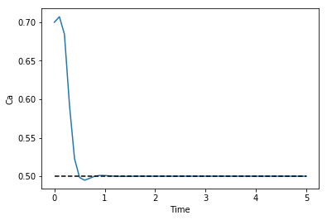
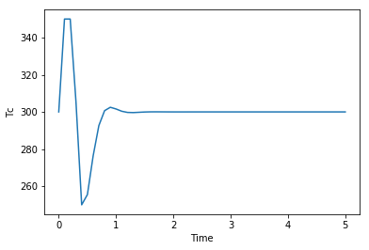
NMPC – Nonlinear Model Predictive Control
#Global options
m.options.IMODE = 6
m.options.CV_TYPE = 2
#MV tuning
Tc.STATUS = 1
#CV Tuning
Ca.STATUS = 1
Ca.SP = .5
m.solve()

Slide 28
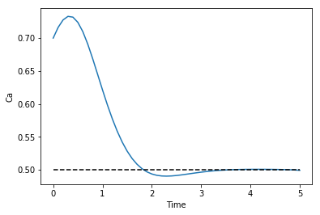
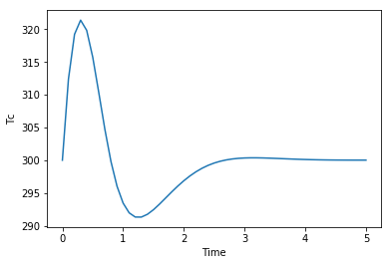
Tuning
#Global options
m.options.IMODE = 6
m.options.CV_TYPE = 2
#MV tuning
Tc.STATUS = 1
Tc.DCOST = .01
#CV Tuning
Ca.STATUS = 1
Ca.SP = .5
m.solve()

Slide 29
Online Model
Generic first order model
Simulation and control
Measurements
Control moves
Time shifting

Slide 30
Models
#%%Import packages
import numpy as np
from random import random
import matplotlib.pyplot as plt
from gekko import GEKKO
#%% Process
p = GEKKO()
p.time = [0,.5] #time discretization
#Parameters
p.u = p.MV()
p.K = p.Param(value=1.25) #gain
p.tau = p.Param(value=8) #time constant
#Variable
p.y = p.CV(1) #measurement
#Equations
p.Equation(p.tau * p.y.dt() == -p.y + p.K * p.u)
#options
p.options.IMODE = 4
p.options.NODES = 4
def process_simulator(meas):
if meas is not None:
p.u.MEAS = meas
p.solve(disp=False)
return p.y.MODEL + (random()-0.5)*0.2
#%% MPC Model
c = GEKKO()
c.time = np.linspace(0,5,11) # discretization (steps of 0.5)
#Parameters
u = c.MV(lb=-10,ub=10) #input
K = c.Param(value=1) #gain
tau = c.Param(value=10) #time constant
#Variables
y = c.CV(1)
#Equations
c.Equation(tau * y.dt() == -y + u * K)
#Options
c.options.IMODE = 6 #MPC
c.options.CV_TYPE = 1 #l1 norm
c.options.NODES = 3
y.STATUS = 1 #write MPC objective
y.FSTATUS = 1 #recieve measurements
y.SPHI = 3.1
y.SPLO = 2.9
u.STATUS = 1 #enable optimization of MV
u.FSTATUS = 0 #no feedback
u.DCOST = 0.05 #discourage unnecessary movement

Slide 31
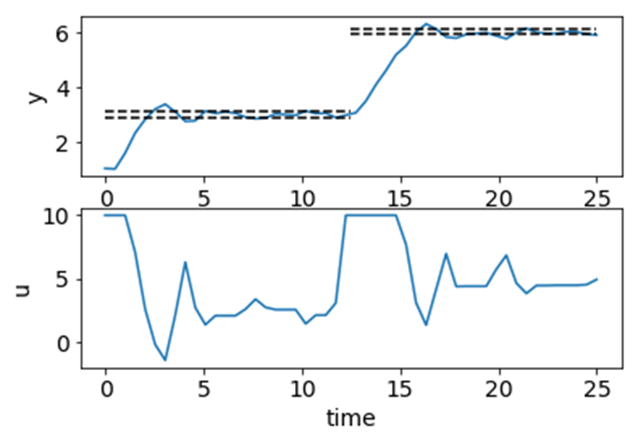
Time Loop
#%% Time loop
for i in range(50):
if i == 24: ##change setpoint
y.SPHI = 6.1
y.SPLO = 5.9
#process
y.MEAS = process_simulator(u.NEWVAL)
#controller
c.solve()

Slide 32
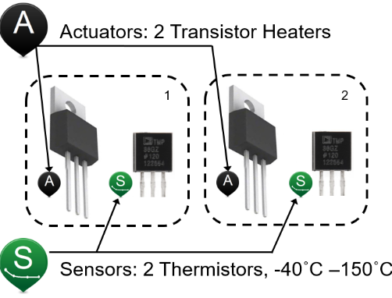
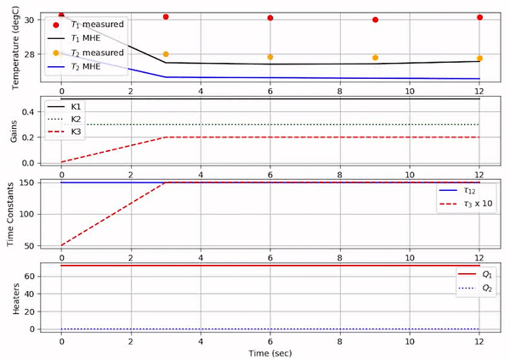
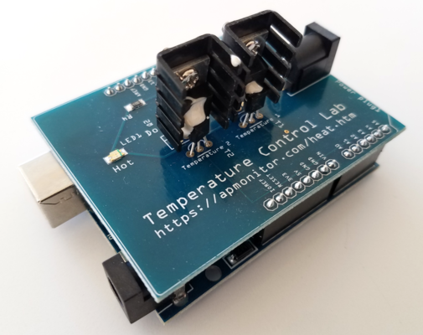
TCLab Estimation

Slide 33
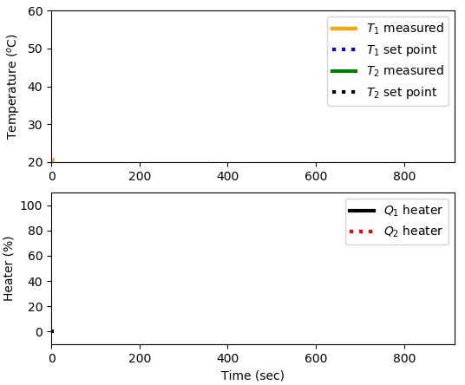
TCLab Predictive Control

Slide 34
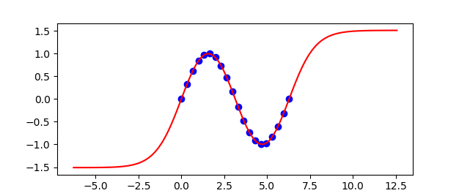
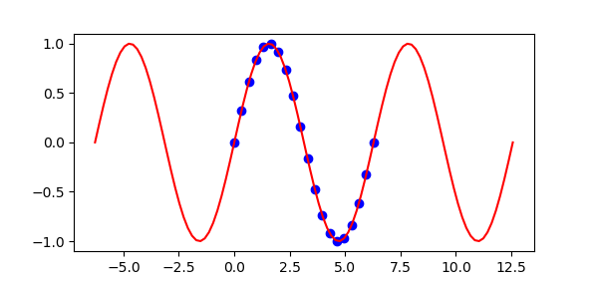
Hybrid Neural Networks
Combine First Principles and Data Driven Modeling
Standard
ANN
Hybrid
ANN

Slide 35
GUI

Slide 36
Why GUI
Rapid viewing
Online watching
Client/server structure

Slide 37
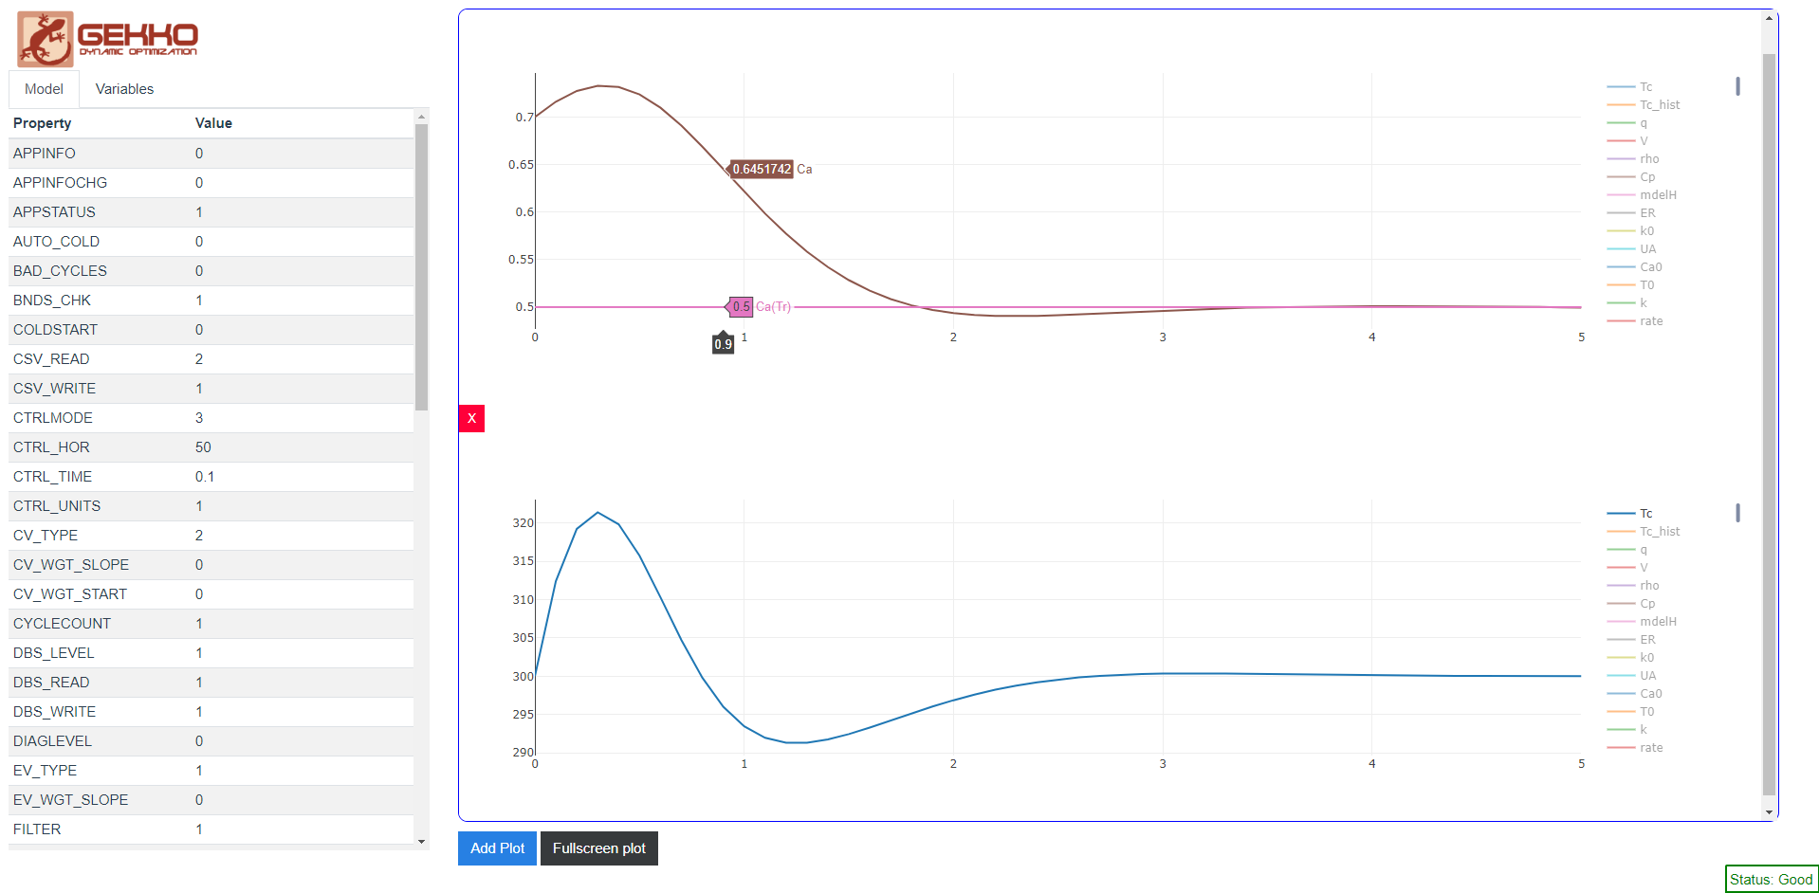
MPC GUI Sample
Concentration
Concentration Target
Manipulated Variable

Slide 38
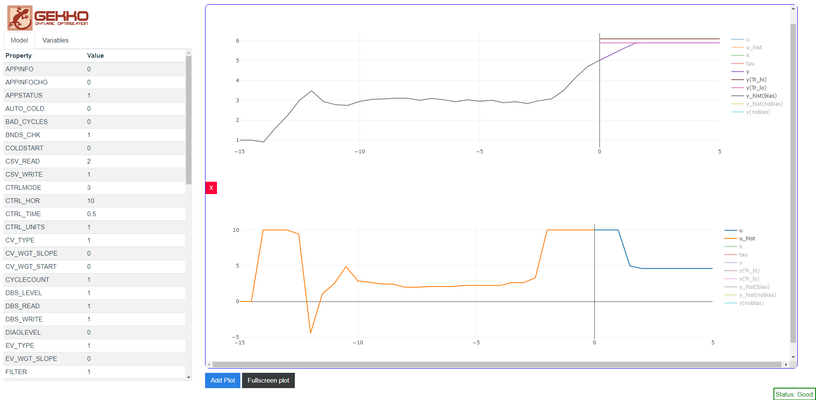
View History and Future Move Plan
Anticipated
Trajectory
Recent Data
Future Move
Plan

Slide 39
Extras

Slide 40
Connections
Allow flexibility
Optimal Control Problems
Periodic constraints

Slide 41
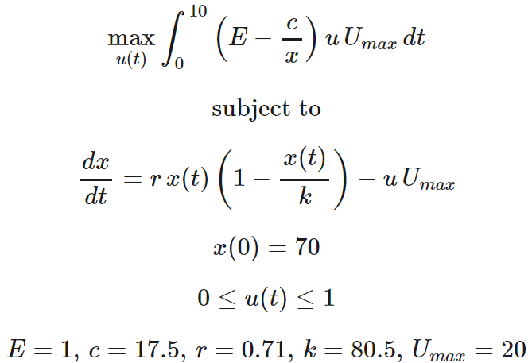
Optimal Control Problem
from gekko import GEKKO
import numpy as np
import matplotlib.pyplot as plt
# create GEKKO model
m = GEKKO()
m.time = np.linspace(0,10,501)
# constants
E = 1
c = 17.5
r = 0.71
k = 80.5
U_max = 20
# fishing rate
u = m.MV(value=1,lb=0,ub=1)
u.STATUS = 1
u.DCOST = 0
# fish population
x = m.Var(value=70)
# fish population balance
m.Equation(x.dt() == r*x*(1-x/k)-u*U_max)
# objective (profit)
J = m.Var(value=0)
m.Equation(J.dt() == (E-c/x)*u*U_max)
# final objective
Jf = m.FV()
Jf.STATUS = 1
m.Connection(Jf,J,pos2='end')
# maximize profit
m.Obj(-Jf)
# options
m.options.IMODE = 6
m.options.NODES = 3
m.solve()

Slide 42
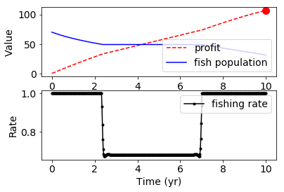

Slide 43
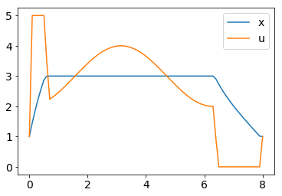
Periodic Constraints
#%%Import packages
import numpy as np
from gekko import GEKKO
import matplotlib.pyplot as plt
#%% Build model
m = GEKKO()
m.time = np.linspace(0,8,81)
#Vars
t = m.Var(0)
x = m.Var(1)
u = m.Var(1,0,5)
#periodic constraints
m.periodic(u)
m.periodic(x)
#Equations
m.Equation(t.dt() == 1)
m.Equation(x.dt() == -x + m.cos(t) + u)
#Objective
m.Obj((x-3)**2)
#options
m.options.IMODE = 6
#solve
m.solve()

Slide 44
Pre-Built Model Components
Discrete / Continuous, State Space, Splines
Other Objects in Development:
MPCCs (ABS, MAX, MIN, SIGNUM, PWL)
Multi-Component Thermo
Object Oriented Flowsheet
Pump, Reactor, Mixer, Stream, Vessel
Splitter, PID, Flow meter, Flash Column
Transfer Function / ARX / FIR
Import DMC (MDL), Profit/RMPCT models

Slide 45
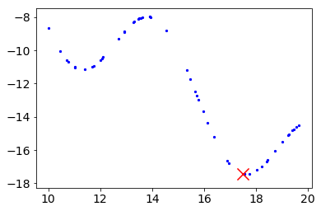
Spline Example
from gekko import GEKKO
import numpy as np
import matplotlib.pyplot as plt
def f(x): # function to generate data for cspline
return 3*np.sin(x) - (x-3)
x_data = np.random.rand(50)*10+10
y_data = f(x_data)
c = GEKKO()
x = c.Var(value=np.random.rand(1)*10+10)
y = c.Var()
c.cspline(x,y,x_data,y_data,True)
c.Obj(y)
c.solve()
plt.figure()
plt.scatter(x_data,y_data,5,'b')
plt.scatter(x.value,y.value,200,'r','x')

Slide 46
State Space Example
from gekko import GEKKO
import numpy as np
## Linear model of a Boeing 747
A = np.array([[-.003, 0.039, 0, -0.322],
[-0.065, -0.319, 7.74, 0],
[0.020, -0.101, -0.429, 0],
[0, 0, 1, 0]])
B = np.array([[0.01, 1],
[-0.18, -0.04],
[-1.16, 0.598],
[0, 0]])
C = np.array([[1, 0, 0, 0],
[0, -1, 0, 7.74]])
#%% Build model
m = GEKKO()
x,y,u = m.state_space(A,B,C)
m.time = [0,0.1,0.2,0.4,1,1.5,2,3,4,5,6,7,8,10,12,15,20] m.options.IMODE = 6
## MV tuning
for i in range(len(u)):
u[i].lower = -5
u[i].upper = 5
u[i].dcost = 1
u[i].status = 1
## CV tuning
# tau = first order time constant for trajectories
y[0].tau = 3
y[1].tau = 5
# tr_init = 2 (first order traj)
y[0].tr_init = 2
y[1].tr_init = 2
# targets (dead-band needs upper and lower values)
y[0].sphi= -8.5
y[0].splo= -9.5
y[1].sphi= 5.4
y[1].splo= 4.6
y[0].status = 1
y[1].status = 1
m.solve()

Slide 47
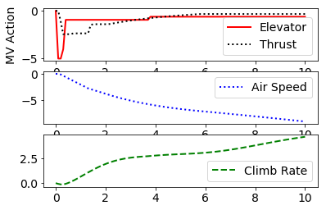
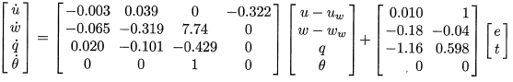
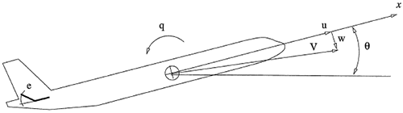
MPC with State Space Model

Slide 48
Additional Resources
Documentation
http://gekko.readthedocs.io
GitHub Repo
https://github.com/BYU-PRISM/GEKKO
Open Access Paper
Beal, L.D.R.; Hill, D.C.; Martin, R.A.; Hedengren, J.D. GEKKO Optimization Suite. Processes 2018, 6, 106.
Dynamic Optimization Online Course
http://apmonitor.com/do

